Slide 1
Harbor Operator
Why and how?

Slide 2
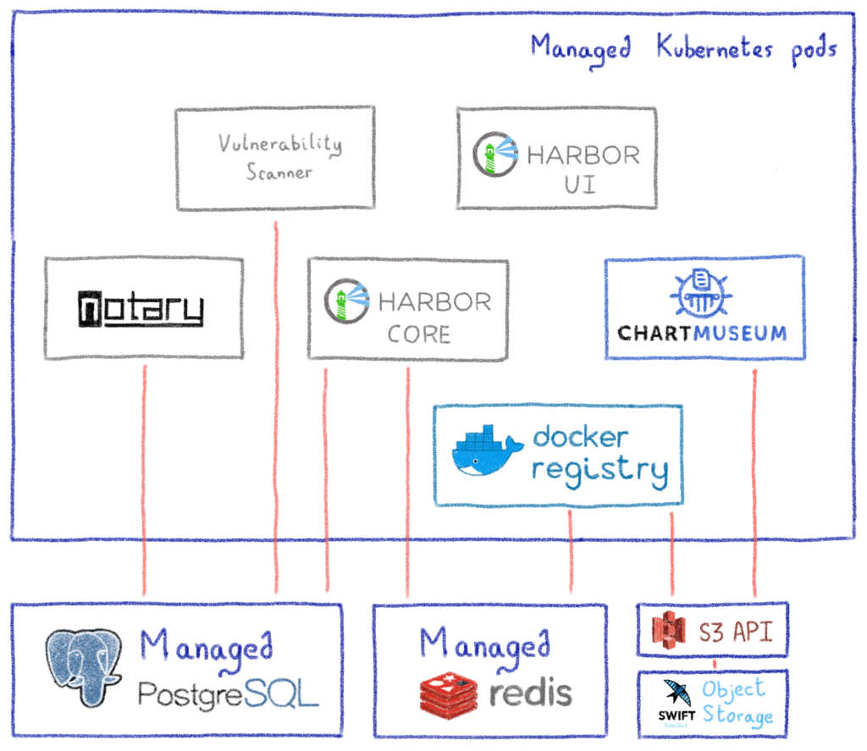
Why an operator...
Cloud Provider needs
Manage hundreds of Harbor stacks
Deploy on demand
React on specific component (triggered by events)

Slide 3
How does it works
Specifications defined in a CustomResourceDefinition
Public URL
Database and storage configuration
Simple use-cases
Add Harbor resource in K8S apiserver
Operator receives the event
Construct go objects to deploy
Apply resources to the same K8S
Update Harbor resource
Operator receives event
Construct go objects to deploy
Delete unwanted resources
Apply new resources
Delete Harbor resource
Nothing to do, Kubernetes deletes all resources
Hardly simplified: async api to apply Helm charts...

Slide 4
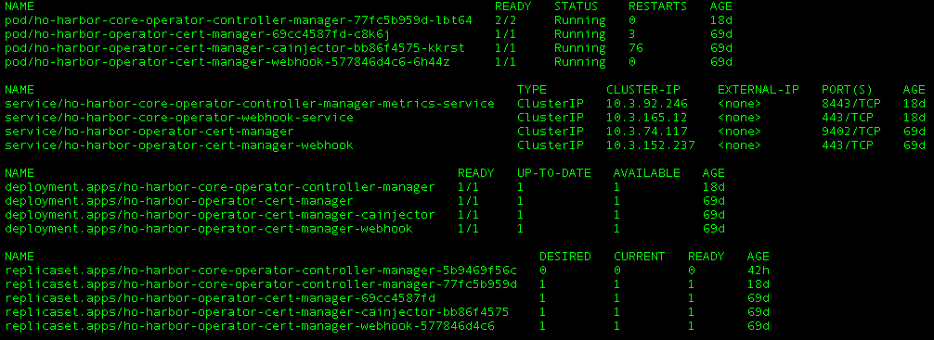
Single application…
With some requirements
Demonstration

Slide 5
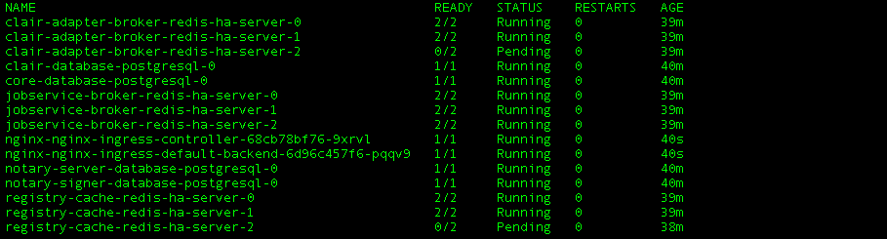
Manage Harbor resources…
With some requirements
Demonstration

Slide 6
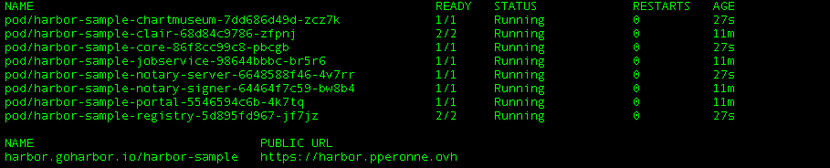
Manage Harbor resources…
With some requirements
Demonstration

Slide 7

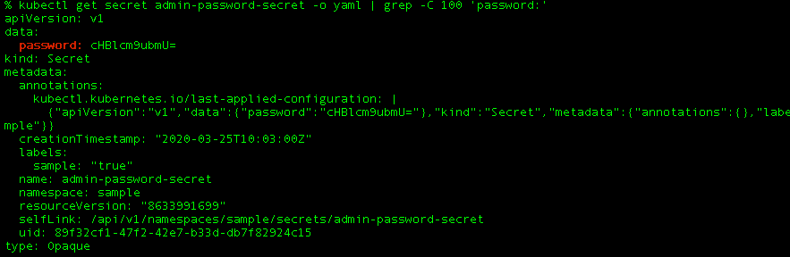
All info are now accessible
through Kubernetes API
Demonstration

Slide 8
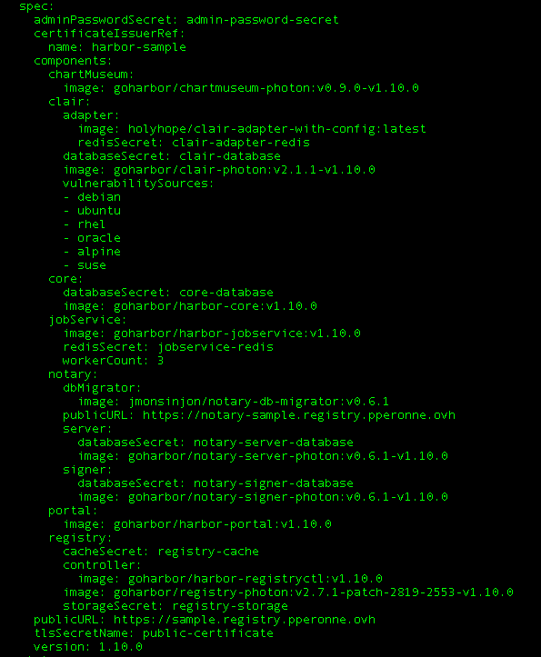
Harbor specs
≠
Harbor config

Slide 9
Improvements incoming
Release 0.5
Easy install
Documentation
Release 1.0
Split specifications
Kubernetes resource statuses

